Slide 1
Accessing, Cleaning, Sharing Data & Code Shell/bash
Lecture 3 & Lecture 4

Slide 2
Today and next class
We will learn what command line is, and how we can use it to increase:
Our ability to reproduce analyses
Access significantly more computational power through clusters and cloud computing!
We will also learn how to version control our code, whether using R or shell scripting, using Github.

Slide 3
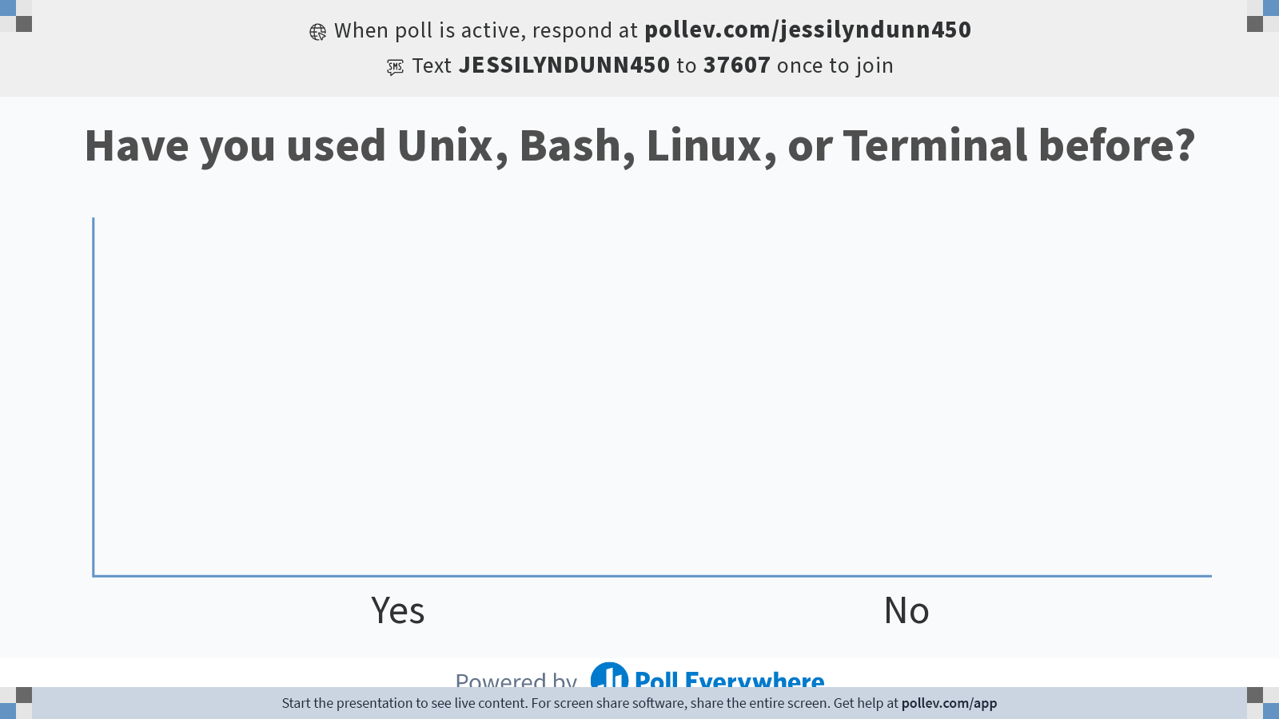
Notes:
Do not modify the notes in this section to avoid tampering with the Poll Everywhere activity. More info at polleverywhere.com/support Have you used Unix, Bash, Linux, or Terminal before?
https://www.polleverywhere.com/multiple_choice_polls/tumnDDYEmXt8q0ydtKS9n?state=opened&flow=Default&onscreen=persist

Slide 4
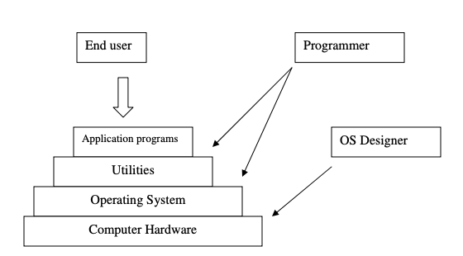
General Compute Architecture
Adapted from Ananda Gunawardena
Notes:
End users interface with the computer at the application level, while programmers deal with utilities and operating system level.

Slide 5
Graphical User Interface vs. Command Line Interface
Applications and system utilities are launched using a shell (a textual command line interface) or a graphical user interface that provides direct user interaction.
5

Slide 6
Example Graphical User Interface (GUI)
6

Slide 7
Example Command Line Interface (CLI)
7

Slide 8
Advantages of a Command Line Interface
If the user knows the correct commands, then CLI can be much faster than GUI
CLI needs much less memory (Random Access Memory, RAM) and does not use as much CPU processing time compared with GUI.
Makes connecting to Github, clusters, and cloud computing easy
https://er.yuvayana.org/command-line-interface-application-advantages-disadvantages/

Slide 9
What is a Shell?
A shell is a CLI
Before computers had a GUI, you had to communicate with them by entering words on a keyboard.
The reason there are different shells (bash, zsh) is that the original Unix shell 'sh' was very limited.
People created new shells that better met their needs
https://www.quora.com/What-is-the-difference-between-UNIX-Linux-Bash-Zsh-shell-programming-and-shell-scripting-What-is-meant-by-the-word-shell

Slide 10
File Systems and Directories
root directory (aka root folder, aka root)
Parent directory of jelkner
subdirectory of home
.txt enstension indicates a text file
http://www.openbookproject.net/tutorials/getdown/unix/lesson2.html
Notes:
A directory (or folder) is a special type of file that can contain other files and directories within it. Directories are used to organize files to make them easier to find.
Since a directory can have directories inside it, and those directories can directories inside them, and so on, we end up with atree structure for the file system.
A directory that contains a file or directory is called the parent directory of that file or subdirectory.

Slide 11
Paths
The absolute path to this file is /home/jelkner/webappdev/unix/notes/lesson1.txt
http://www.openbookproject.net/tutorials/getdown/unix/lesson2.html
Notes:
The absolute path to any file in the filesystem is the sequence of directories, starting from the root and ending with the file.

Slide 12
Demo
How do we navigate in between folders/files in the GUI vs CLI?
How do we create a new file using GUI vs CLI?
How do we check contents of files?
How do we move them around?
How do we manipulate files? Perform calculations? → coding!
Notes:
Use “open” command

Slide 13
Demo of Unix Commands
pwd
.
ls
nano/vim
mkdir
cd
cp
mv
man
echo / printf
more
less
head
rm** CAREFUL!
Recursive commands
rm –r ** VERY DANGEROUS!
Notes:
.. = one directory above current directory
~ = home directory
less filename: = shows contents of a file
head filename = gives header of file
tail filename = gives last line of file
head -10 filename = gives the first 10 lines of the file
Ctrl+L = clears command line
cp filenameOld filenameNew = copies filenameOld to filenameNew
rm filename = removes file
rm –r dirname = removes directory and all its contents
ls * = lists everything
ls f* = lists everything that begins with an f
mv filename pathLoc = moves a file to the specified path
man mv = gives the manual information on the mv command

Slide 14
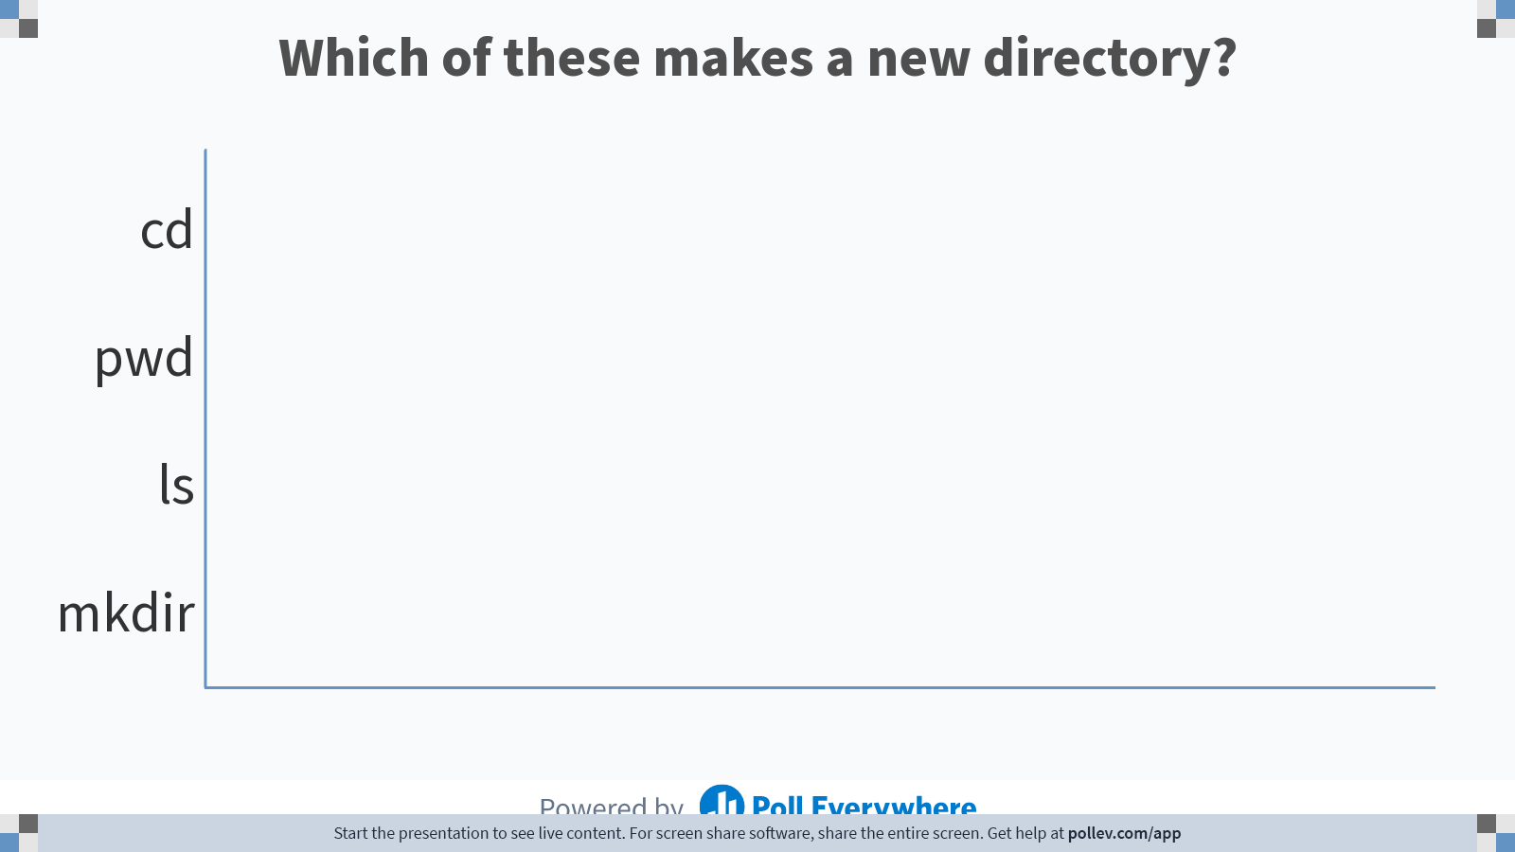
Notes:
Do not modify the notes in this section to avoid tampering with the Poll Everywhere activity. More info at polleverywhere.com/support Which of these makes a new directory?
https://www.polleverywhere.com/multiple_choice_polls/uzs5kQUXPBJShfSK8A6Qw

Slide 15
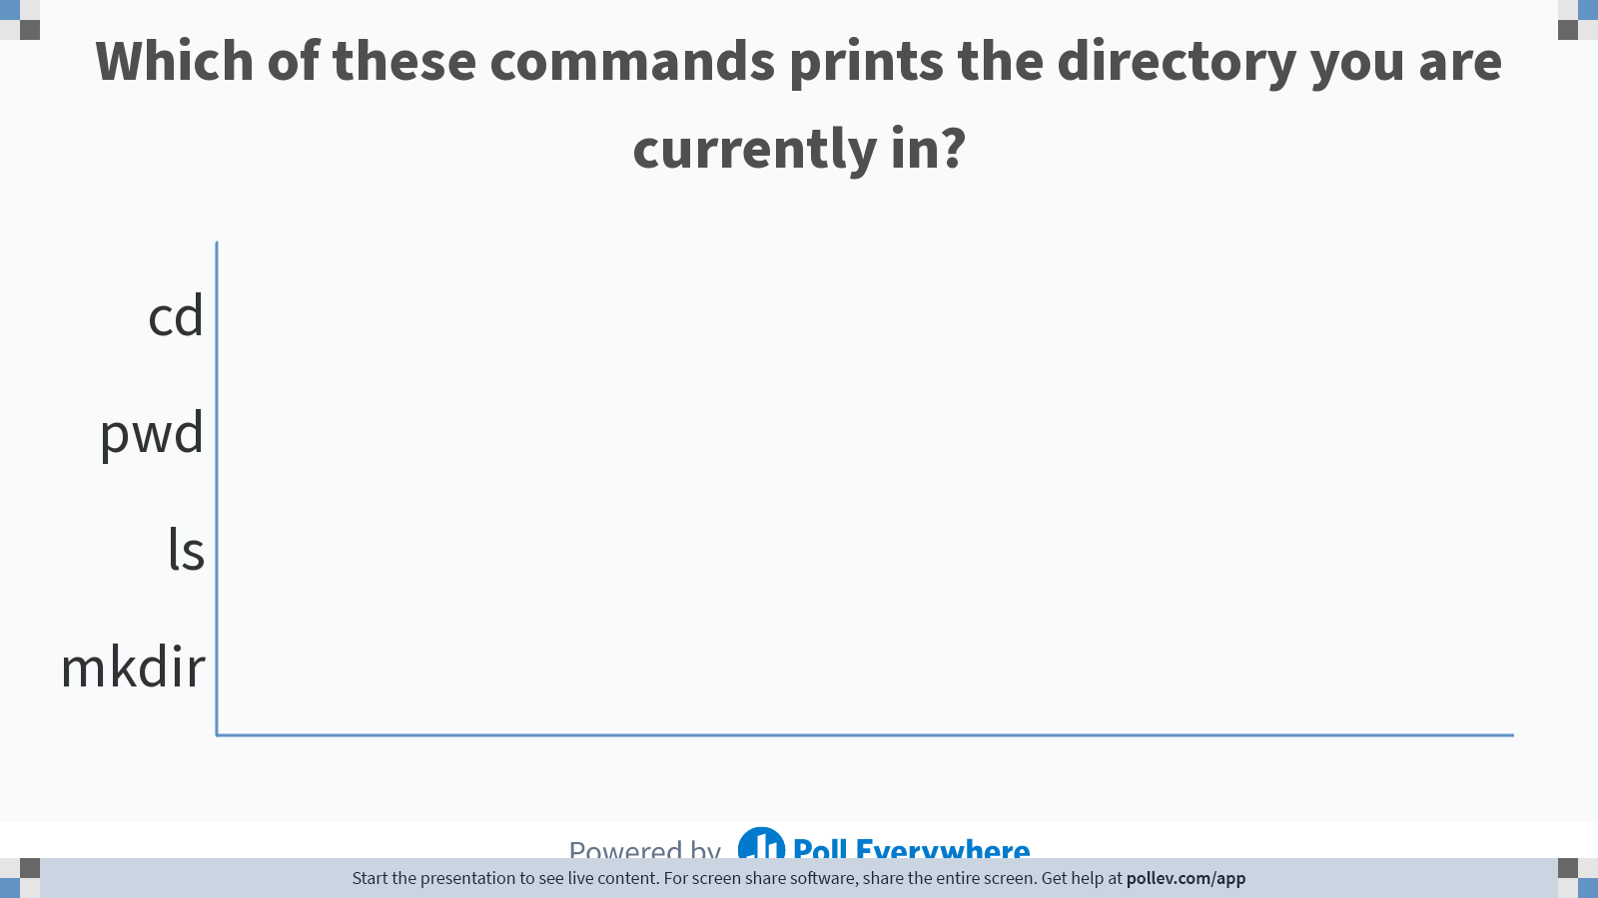
Notes:
Do not modify the notes in this section to avoid tampering with the Poll Everywhere activity. More info at polleverywhere.com/support Which of these commands prints the directory you are currently in?
https://www.polleverywhere.com/multiple_choice_polls/heZbrY46c2Q98AZeYTWZJ

Slide 16
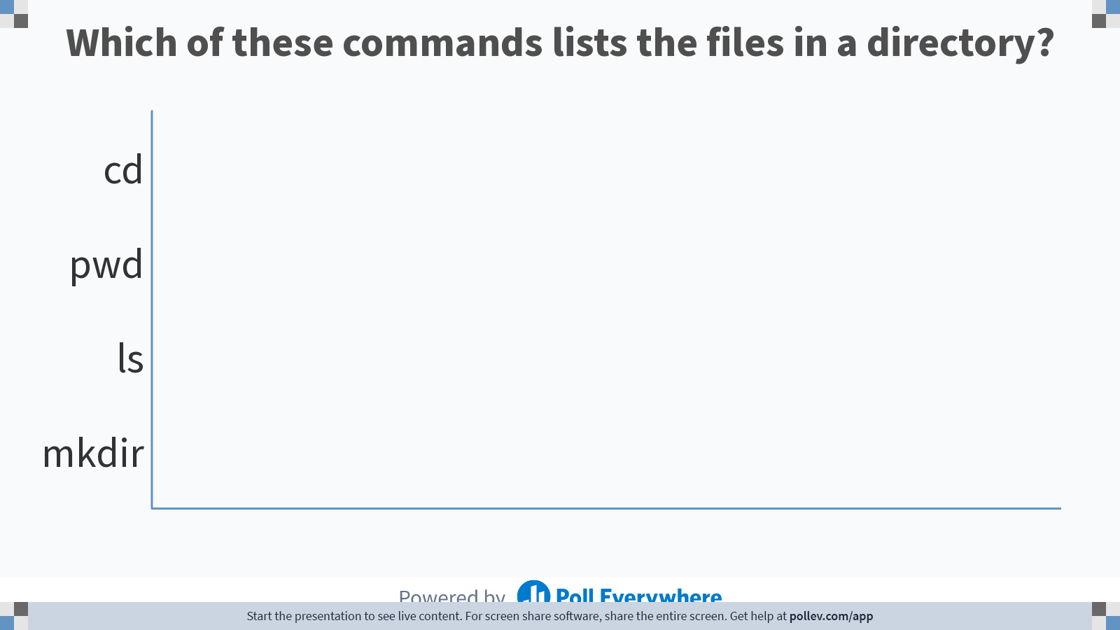
Notes:
Do not modify the notes in this section to avoid tampering with the Poll Everywhere activity. More info at polleverywhere.com/support Which of these commands lists the files in a directory?
https://www.polleverywhere.com/multiple_choice_polls/6BlDipHq4TS81qUKhdtKB

Slide 17
Useful Bash Commands in Data Science
awk – processing text
grep – pattern searching (RegEx)
sed – stream editor
tr
wc
sort
cut
uniq
Regex & wildcards (*)
https://medium.com/@kadek/command-line-tricks-for-data-scientists-c98e0abe5da

Slide 18
Piping
The Pipe is a command in Linux that lets you use two or more commands such that output of one command serves as input to the next.
output of each process is direct input to next one
Like a pipeline
The symbol '|' denotes a pipe.
printf "welcome to BME590 \nwe love it here \nit is better than BME590.88" | sed 's/BME590/BME590.12/' | grep "we"

Slide 19
Piping

Slide 20
Useful Bash Commands in Data Science
awk – processing text
grep – pattern searching (RegEx)
sed – stream editor
tr
wc
sort
cut
uniq
Regex & wildcards (*)
https://medium.com/@kadek/command-line-tricks-for-data-scientists-c98e0abe5da

Slide 21

Sed & Awk: Two mainstays of the UNIX programmer's toolbox
This is a 400 page book ☺
However, these commands can become your best friend with just a 15 minute tutorial
https://www.amazon.com/sed-awk-Dale-Dougherty/dp/1565922255/ref=sr_1_1?ie=UTF8&qid=1524381457&sr=8-1&keywords=sed+and+awk

Slide 22
AWK
Abbreviated from the names of the developers
Aho, Weinberger, Kernighan.
Awk is a utility that enables a programmer to write tiny but effective programs in the form of statements that define text patterns that are to be searched for in each line of a document and the action that is to be taken when a match is found within a line.
mostly used for pattern scanning and processing.
searches one or more files to see if they contain lines that matches with the specified patterns and then performs the associated actions.
http://www.grymoire.com/Unix/Awk.html
https://www.geeksforgeeks.org/awk-command-unixlinux-examples/

Slide 23
What Can We Do With Awk?
AWK Operations
Scans a file line by line
Splits each input line into fields
Compares input line/fields to pattern
Performs action(s) on matched lines
Awk’s built-in variables include the field variables—$1, $2, $3, and so on ($0 is the entire line) — that break a line of text into individual words or pieces called fields.
http://linuxcommand.org/lc3_adv_awk.php
https://www.geeksforgeeks.org/awk-command-unixlinux-examples/

Slide 24
Try searching online how to use Awk to…
Find out how many columns there are in the file smartwatch_data.csv?
Look at rows where the type of activity is running
Find out how many rows there are where the type of activity is running?
Print only the type of activity and the HR

Slide 25
Tr
Tr is analogous to translate. This powerful utility is a workhorse for basic file cleaning. An ideal use case is for swapping out the delimiters within a file.
Converting a tab delimited file into commas

Slide 26
Try searching online how to use tr to…
5. Replace the commas with tabs in smartwatch_data.csv; print this output to a new file called tab_delimited_smartwatch_data.csv
6. Replace the commas with asterisks in smartwatch_data.csv; print this output to a new file called asterisk_delimited_smartwatch_data.csv

Slide 27
Regular Expressions
aka Regex
a sequence of characters that define a search pattern.
Usually such patterns are used by string searching algorithms for "find" or "find and replace" operations on strings, or for input validation.

Slide 28
Try searching online how to use RegEx to…
7. Replace all of the lower case letters with capital letters in the smartwatch_data.csv file

Slide 29
(?<=\.) {2,}(?=[A-Z])
At least two spaces are matched, but only if they occur directly after a period (.) and before an uppercase letter.

Slide 30
Grep
Global search for a regular expression and print, or grep; likely, the most well known command, and with good reason. Grep has a lot of power, especially for finding your way around large codebases. Within the realm of data science, it acts as a refining mechanism for other commands. Although its standard usage is valuable as well.
Count total number of lines containing word / pattern.
https://www.geeksforgeeks.org/grep-command-in-unixlinux/

Slide 31
Try searching online how to use grep to…
8. Use grep to look at the rows where the type of activity is running
9. Use grep to look at all measurements from a specific date (e.g., 6/7/26)

Slide 32
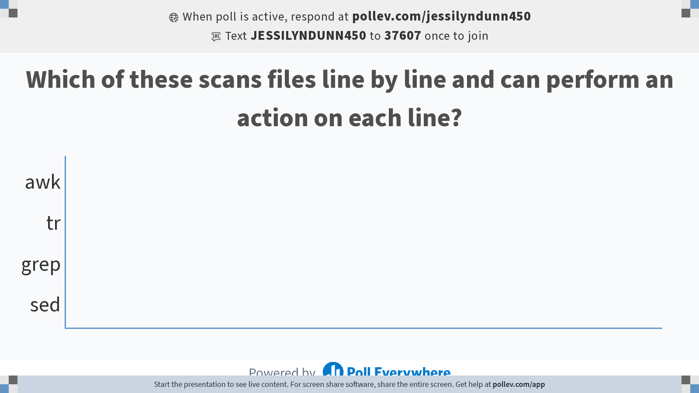
Notes:
Do not modify the notes in this section to avoid tampering with the Poll Everywhere activity. More info at polleverywhere.com/support Which of these scans files line by line and can perform an action on each line?
https://www.polleverywhere.com/multiple_choice_polls/cCF1wdid6yjdxneAE8CRw?state=opened&flow=Default&onscreen=persist

Slide 33
Computing on a Cluster
A computer cluster is a set of loosely or tightly connected computers (nodes) that work together so that, in many respects, they can be viewed as a single system.
https://en.wikipedia.org/wiki/Computer_cluster
Notes:
https://www.breeze-software.com/services/high-speed-modeling/cluster-computing/

Slide 34
Benefits of Computing on a Cluster
Clusters are usually used to improve performance & availability over that of a single computer
They are also typically much more cost-effective than single computers of comparable speed or availability.
The concept has been around since the 1960s
Performance/Speed
providing parallel data processing and high processing capacity
Reliability/Availability
Enable data recovery in the event of a disaster
Fault tolerance (the ability for a system to continue working with a malfunctioning node)
Enables scalability
https://oit.duke.edu/help/articles/cluster-how-log

Slide 35
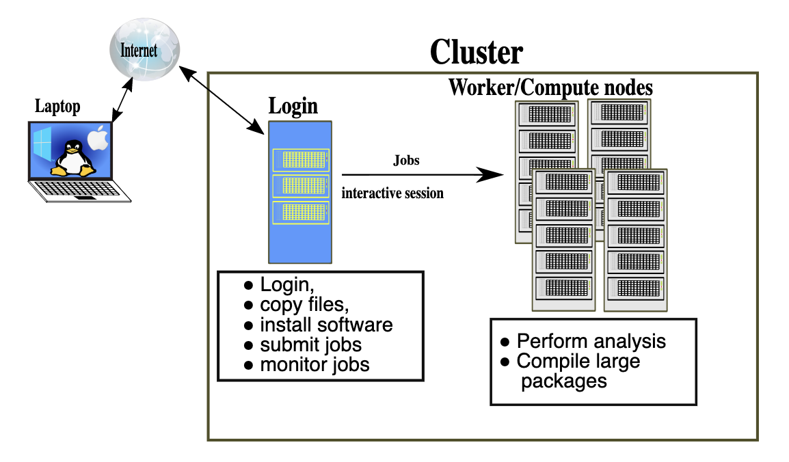
Working locally vs remotely
https://sabryr.github.io/hpc-intro/12-cluster/index.html

Slide 36
Try it yourself: Log onto the Duke Compute Cluster (DCC)
ssh YOUR_NETID@dcc-login.oit.duke.edu
& look around!
Instructions can be found here: https://dcc.duke.edu/dcc/login/

Slide 37
put, get, wget
Put, get:
Moving files to and from the cluster from your local drive
Wget, curl
Downloading files from the internet to a remote server (e.g. the cluster)

Slide 38
What is Shell Scripting?
Like writing a script in any computing language (R, Python, Matlab, etc.)
Combining a set of commands into a single text-based file, rather than typing each one individually into a command line / console
The shell executes the commands in the text file just like you had typed them in.
https://www.amazon.com/Classic-Shell-Scripting-Arnold-Robbins/dp/0596005954/ref=pd_bxgy_img_3/147-2925148-0357648?_encoding=UTF8&pd_rd_i=0596005954&pd_rd_r=bd3931c2-3d43-4fc3-9392-d93555de74bb&pd_rd_w=dtd8I&pd_rd_wg=dQHHg&pf_rd_p=09627863-9889-4290-b90a-5e9f86682449&pf_rd_r=1QN2XXTTAW6YPAQCFPW7&psc=1&refRID=1QN2XXTTAW6YPAQCFPW7
https://www.quora.com/What-is-the-difference-between-UNIX-Linux-Bash-Zsh-shell-programming-and-shell-scripting-What-is-meant-by-the-word-shell

Slide 39
Shell Scripting
shebang
#!/bin/bash # example of using arguments to a script echo "My first name is $1" echo "My last name is $2" echo "Total number of arguments is $#"
Save this file as name.sh, set execute permission on that file by typing chmod a+x name.sh and then execute the file like this: ./name.sh.
$ chmod a+x name.sh
$ ./name.sh Hans-Wolfgang Loidl
https://www.macs.hw.ac.uk/~hwloidl/Courses/LinuxIntro/x945.html

Slide 40
Github
Recall that we use version control and code sharing software to support reproducible data science!

Slide 41
What is GitHub?
GitHub is an open-source repository hosting service for code.
Variety of different programming languages
Keeps track of the various changes made to every iteration by using git, a revision control system that runs in the command line interface
Notes:
Source: https://www.thebalancecareers.com/what-is-github-and-why-should-i-use-it-2071946

Slide 42
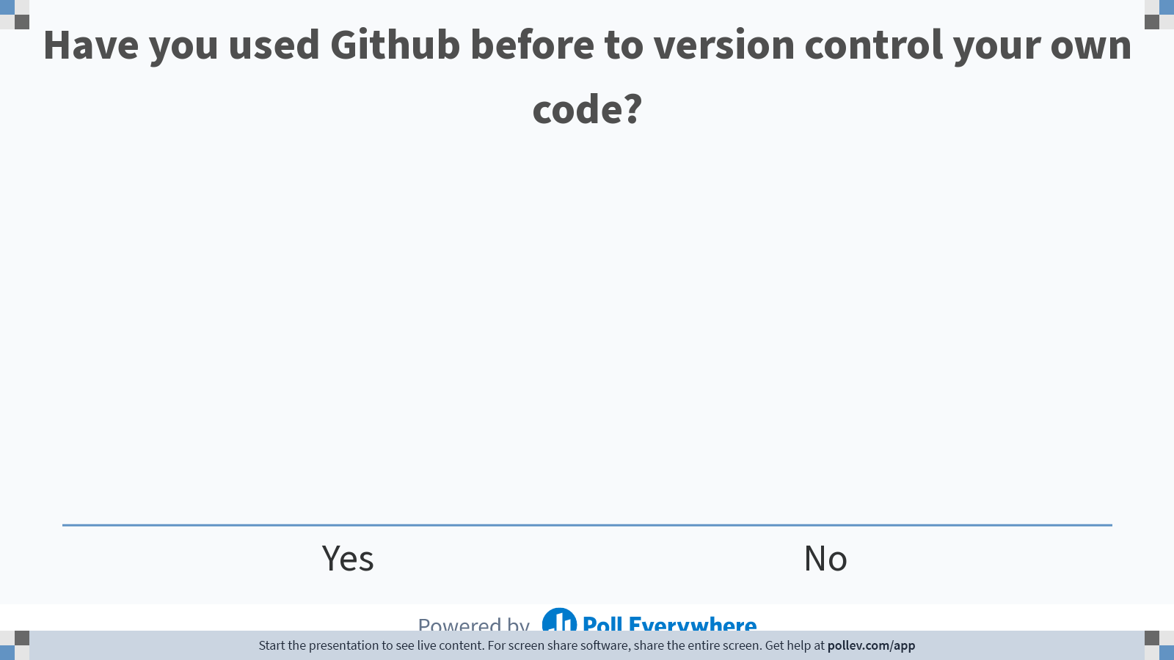
Notes:
Do not modify the notes in this section to avoid tampering with the Poll Everywhere activity. More info at polleverywhere.com/support Have you used Github before to version control your own code?
https://www.polleverywhere.com/multiple_choice_polls/DUknQPfycNFz2fok7mVHg

Slide 43
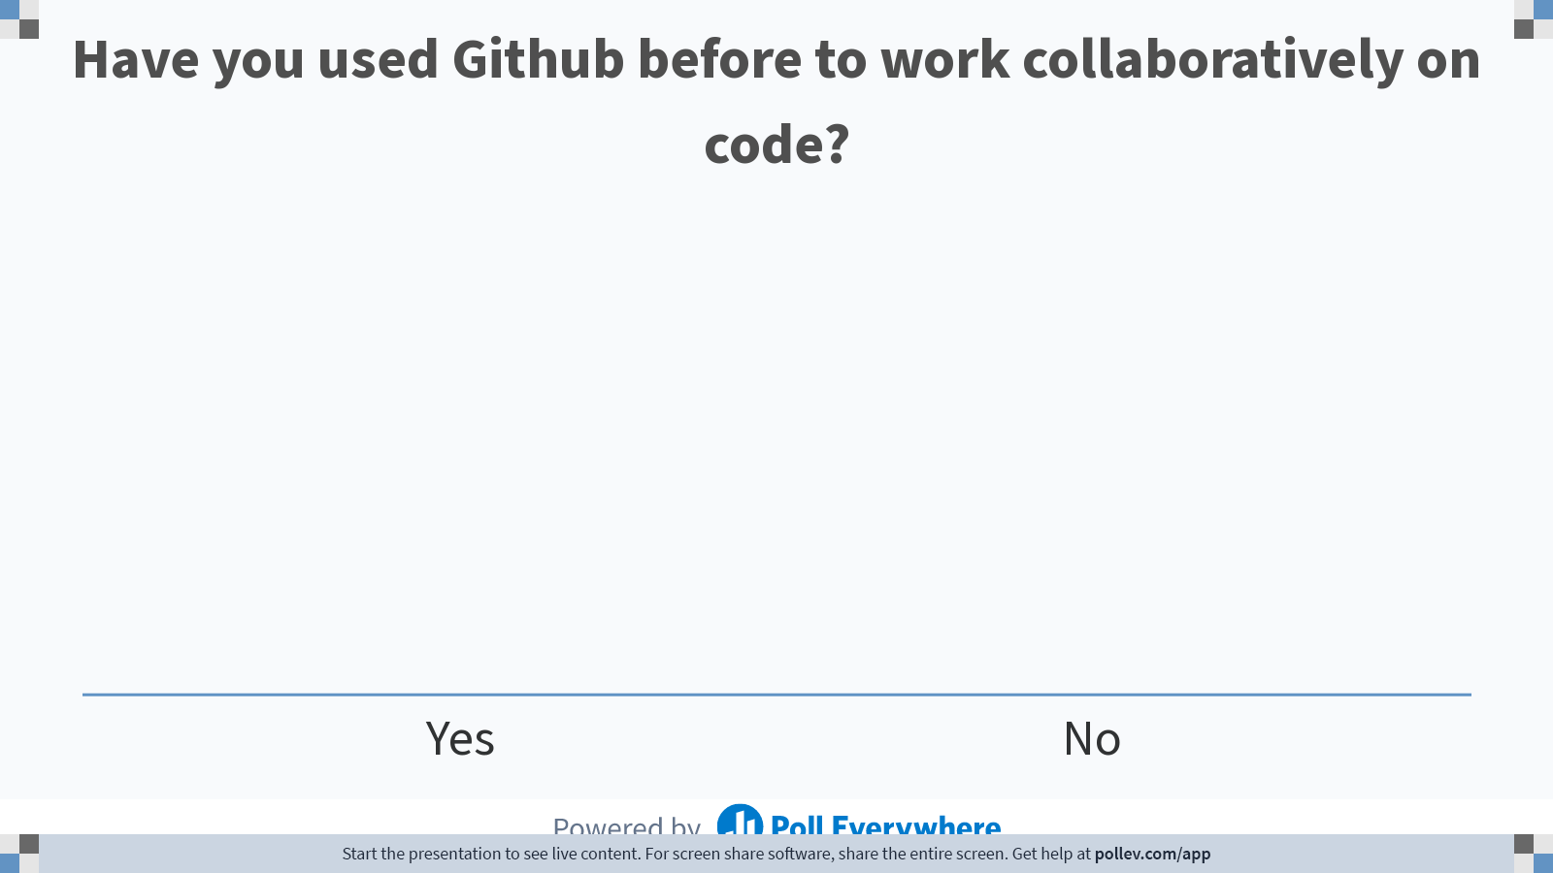
Notes:
Do not modify the notes in this section to avoid tampering with the Poll Everywhere activity. More info at polleverywhere.com/support Have you used Github before to work collaboratively on code?
https://www.polleverywhere.com/multiple_choice_polls/OijvSuoAcZ17xsNN511IZ

Slide 44
Why should I be using GitHub?
> 28 million users- huge network!
Allows for easy collaborations
Trackable
Enables you to become active in the community
Improve your attractiveness as a job candidate (a public portfolio of your work as a data scientist!)
~1GB/repository (file <50-100MB)

Slide 45
Two Scenarios for Using Git
you want to track your own project
you want to start working on someone else’s project

Slide 46
Where we organize what we want to commit to our repository
https://github.com/fedosejev/front-end-course/blob/master/week-01/day-01/learn-git.md

Slide 47
Git Commands
git config --global [user.name] [user.email]
init
status
add [-filename] [-A]
reset [-filename]
Commit -m
log

Slide 48
Cloning a remote repo
clone <url> <local place to clone>
remote –v
branch –a
diff
push [origin master]
pull
Try cloning the repository at https://github.com/jessilyn/BME590_practice
Add your name to the readme file

